Slide 1
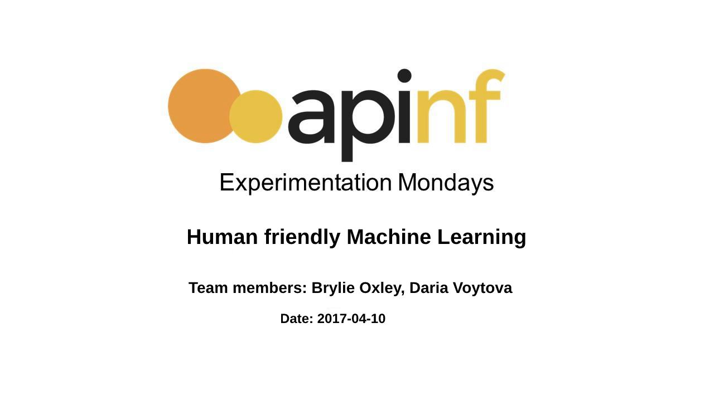

Slide 2
Why do we need that?
Businesses and governments have a lot of data, and want to learn about structures and patterns in the data. This might include being able to make predictions extending from the data. There are myriad tools to help people design Machine Learning workflows. However, there does not appear to be a simple.
General-purpose
Machine Learning toolkit that is accessible via web browser and REST.
General-Goal
Create a REST API for machine learning algorithms. A REST API would make it easy to use Machine Learning algorithms, since users would not have to install or maintain the Machine Learning software.
Create the interactive page with user understanding UI.
UI includes interface for interacting with data, sequencing ML tasks, and accessing output
UI might include basic visualizations to give users insight into data (histogram, etc)

Slide 3
Roadmap
Create draft document describing idea
http://piratepad.net/RKOG0fLeda
Move draft document to Github repository (open license)
Sketch out REST API using design-first API tool
seek feedback on API design from Orange3 developers, APInf team, ML community
Research/choose framework(s) and libraries to commence development
REST framework
UI framework (if applicable)
Visualization framework (if applicable)
Scaffold initial REST API
Create wireframe of User Interface
Prototype initial User Interface using UI framework

Slide 4
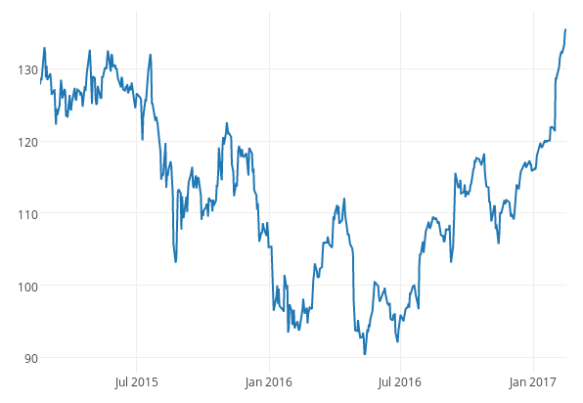
Sample time-series data
Source: https://plot.ly/pandas/time-series/

Slide 5
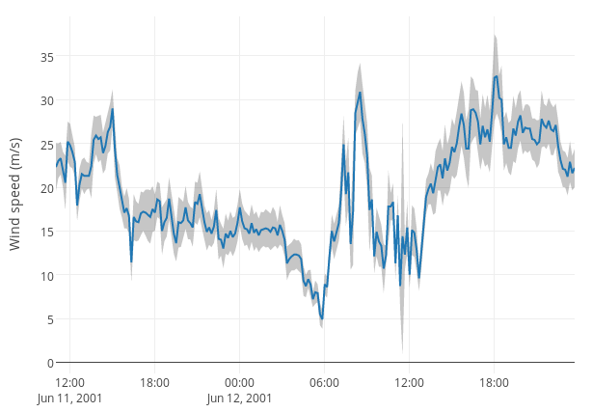
Time-series with error margins
Source: https://plot.ly/pandas/time-series/

Slide 6
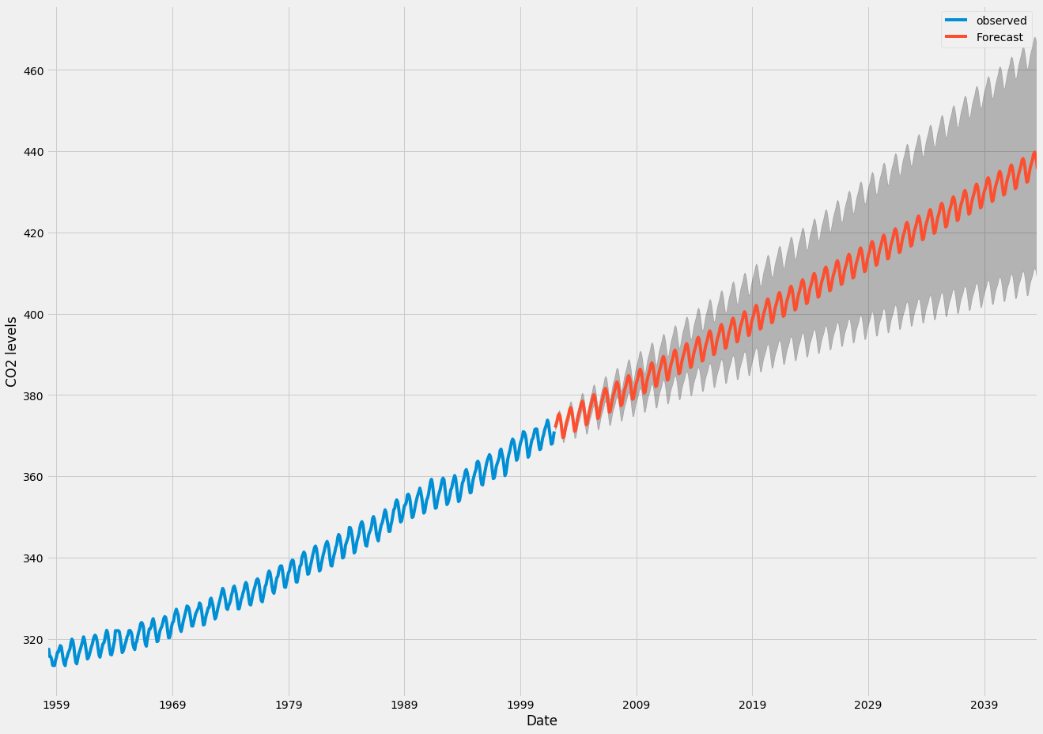
Time-series forecasting
Source: https://www.digitalocean.com/community/tutorials/a-guide-to-time-series-forecasting-with-arima-in-python-3

